Slide 1

Mining Frequent Patterns, Associations, Correlations
Dr. G.Manikandan
ACP / School of Computing
SASTRA Deemed To Be University

Slide 2
Mining Frequent Patterns, Associations, and Correlations
  Frequent Itemset Mining Methods:
    Apriori Algorithm
    Generating Association Rules from Frequent Itemsets
    Variations to the Apriori algorithm

Slide 3
Apriori Algorithm: Finding Frequent
Itemsets by Confined Candidate Generation
Apriori is a seminal algorithm for mining frequent itemsets.
  The name of the algorithm is based on the fact that the algorithm uses prior knowledge of frequent itemset properties
Apriori employs an iterative approach known as a level-wise search, where k-itemsets are used to explore (k + 1)-itemsets.
First,
  the set of frequent 1-itemsets is found by scanning the database to accumulate the count for each item, and collecting those items that satisfy minimum support.
The resulting set is denoted by L₁.

Slide 4
Apriori Algorithm: Finding Frequent
Itemsets by Confined Candidate Generation
Next, L₁ is used to find L₂,
  the set of frequent 2-itemsets, which is used to find L₃, and so on, until no more frequent k-itemsets can be found.
The finding of each L_{k} requires one full scan of the database.
To improve the efficiency of the level-wise generation of frequent itemsets, an important property called the Apriori property is used to reduce the search space.

Slide 5
Apriori Algorithm:
Apriori property: All nonempty subsets of a frequent itemset must also be frequent.
if an itemset I does not satisfy the minimum support threshold, min sup, then I is not frequent, that is, P(I) < min sup.
If an item A is added to the itemset I, then the resulting itemset (i.e., I ∪ A) cannot occur more frequently than I . Therefore, I ∪ A is not frequent either, that is, P(I∪A)<min sup.
This property belongs to a special category of properties called antimonotonicity in the sense that if a set cannot pass a test, all of its supersets will fail the same test as well.

Slide 6
Apriori Algorithm:
“How is the Apriori property used in the algorithm?”
To understand this, let us look at how L_{k−1} is used to find L_{k} for k ≥ 2.
A two-step process
  Join Step:
    This step generates (K+1) itemset from K-itemsets by joining each item with itself.
  Prune Step:
    This step scans the count of each item in the database.
    If the candidate item does not meet minimum support, then it is regarded as infrequent and thus it is removed.
    This step is performed to reduce the size of the candidate itemsets.

Slide 7
Steps In Apriori
1) In the first iteration of the algorithm,
  each item is taken as a 1-itemsets candidate.
  The algorithm will count the occurrences of each item.
2) Let there be some minimum support, min_sup ( eg 2).
  The set of 1 – itemsets whose occurrence is satisfying the min sup are determined.
  Only those candidates which count more than or equal to min_sup, are taken ahead for the next iteration and the others are pruned.

Slide 8
Steps In Apriori
3) Next,
  2-itemset frequent items with min_sup are discovered.
  For this in the join step, the 2-itemset is generated by forming a group of 2 by combining items with itself.
4) The 2-itemset candidates are pruned using min-sup threshold value.
  Now the table will have 2 –itemsets with min-sup only.
The algorithm is stopped when the most frequent itemset is achieved.

Slide 9
Steps In Apriori

Slide 10
Apriori: Example
Min.Sup.Count=2
One Item Set
I1
I2
I3
I4
I5

Slide 11
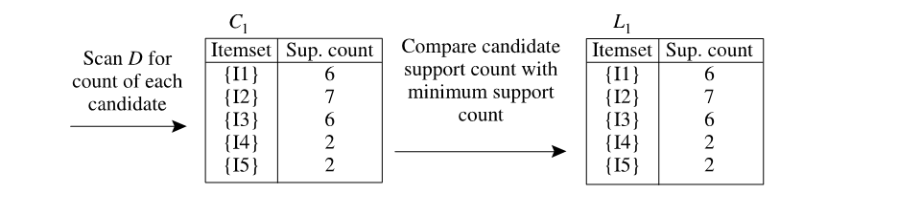
Example

Slide 12
Example

Slide 13
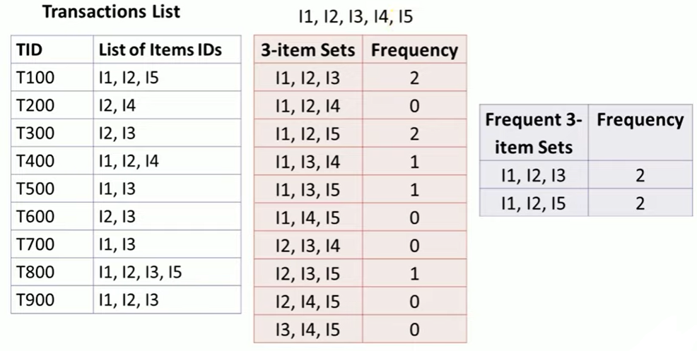
Example
0

Slide 14
Apriori: Example

Slide 15
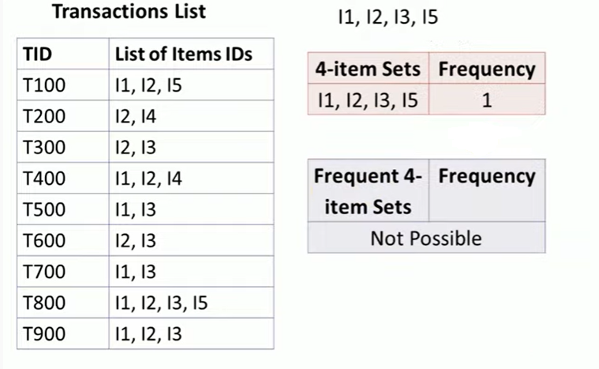
Apriori: Example

Slide 16
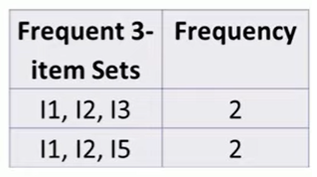
Apriori: Example
Generating Association Rules from Frequent Itemsets

Slide 17
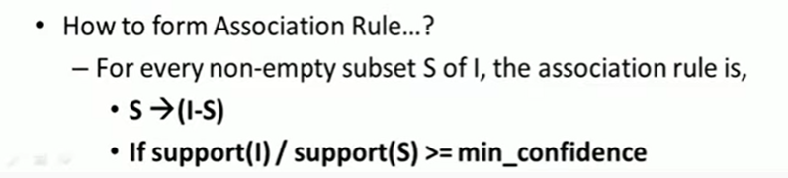
Generating Association Rules from
Frequent Itemsets
The data contain frequent itemset I= {I1, I2, I5}.
What are the association rules that can be generated from I?
The nonempty subsets of I are {I1, I2}, {I1, I5}, {I2, I5}, {I1}, {I2}, and {I5}.

Slide 18
Generating Association Rules from
Frequent Itemsets
The resulting association rules are as shown below, each listed with its confidence:
{I1, I2} ⇒ I5
    Confidence = support (I) / support (s)
    Confidence = support {I1, I2, I5 / support {I1, I2}
    Confidence = (2/ 4)* 100 =50%
{I1, I5} ⇒ I2, confidence = 2/2 = 100%
{I2, I5} ⇒ I1, confidence = 2/2 = 100%
I1 ⇒ {I2, I5}, confidence = 2/6 = 33%
I2 ⇒ {I1, I5}, confidence = 2/7 = 29%
I5 ⇒ {I1, I2}, confidence = 2/2 = 100%
Confidence = 70%

Slide 19
Apriori Algorithm
Advantages
  Easy to understand algorithm
  Join and Prune steps are easy to implement on large itemsets in large databases
Disadvantages
  It requires high computation if the itemsets are very large and the minimum support is kept very low.
  The entire database needs to be scanned.

Slide 20
Improving the Efficiency of Apriori
Transaction reduction (reducing the number of transactions scanned in future iteraions):
  A transaction that does not contain any frequent k-itemsets cannot contain any frequent (k + 1)-itemsets.
Partitioning (partitioning the data to find candidate itemsets):
  A partitioning technique can be used that requires just two database scans to mine the frequent itemsets.

Slide 21
Improving the Efficiency of Apriori
Sampling (mining on a subset of the given data):
  The basic idea of the sampling approach is to pick a random sample S of the given data D, and then search for frequent itemsets in S instead of D.
  In this way, we trade off some degree of accuracy against efficiency.

Slide 22
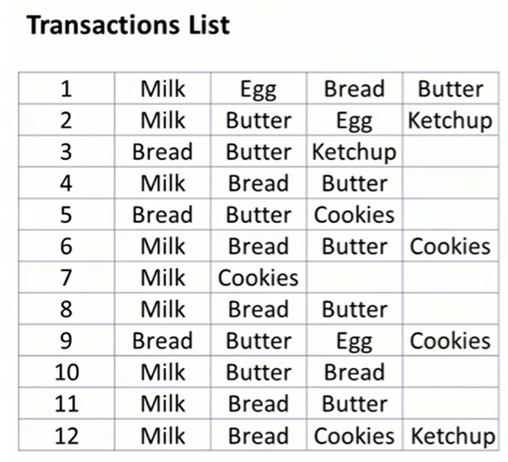
Practice Problem
Support – 33%
Confidence – 50%

Slide 23
References
https://www.youtube.com/watch?v=NT6beZBYbmU
https://www.youtube.com/watch?v=43CMKRHdH30
https://www.youtube.com/watch?v=yXEtrsiuxvQ

Slide 24



